Slide 1

The Technology Value Stream
Rachel Theis
Module 1.2 Assignment
CSD 380
https://github.com/racheltheis/csd-380

Slide 2
The Technology Value Stream
“The process required to convert a business hypothesis into a technology-enabled service that delivers value to the customer”
(Kim et al., 2021)

Slide 3

What is the Technology Value Stream?
Every point on the journey from idea generation to delivery of value to customers
Enables analysis of what is working and what needs to be improved
Rooted in Lean principles
Prioritizes areas for improvement & streamlines flow

Slide 4

Value Stream Mapping
Define the scope and boundaries of the process & requirements
Collect data on the current state of the process
Draw a map that graphically represents the main elements of the business’s process
Calculate the metrics and indicators of the process
Analyze the map to identify sources of waste, variation, and non-value-added activities.

Slide 5
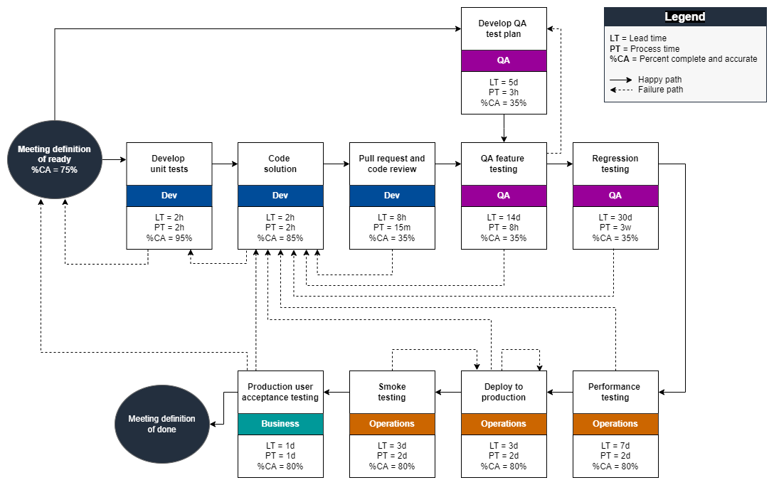
Example Value Stream Map

Slide 6
Key Metrics to Measure
Value added: How much time a team spends actively working on the project. Time that does not result in change is considered non-value added time
Lead time: The total time it takes to complete a task or request by combining the value-added and non-value-added time spent.
Percent Complete/Accurate (%C/A): The percentage of work that is completely correct and doesn’t need to be reworked downstream

Slide 7
Lead Time vs. Processing Time
Lead Time
Processing Time
Clock starts when the request is made & ends when the request is fulfilled
Commonly used measure for process improvement
Directly relates to customer experience
Clock only begins when work begins on the request
Omits time spent in the request queue
Process time to lead time ratio is a valuable metric

Slide 8
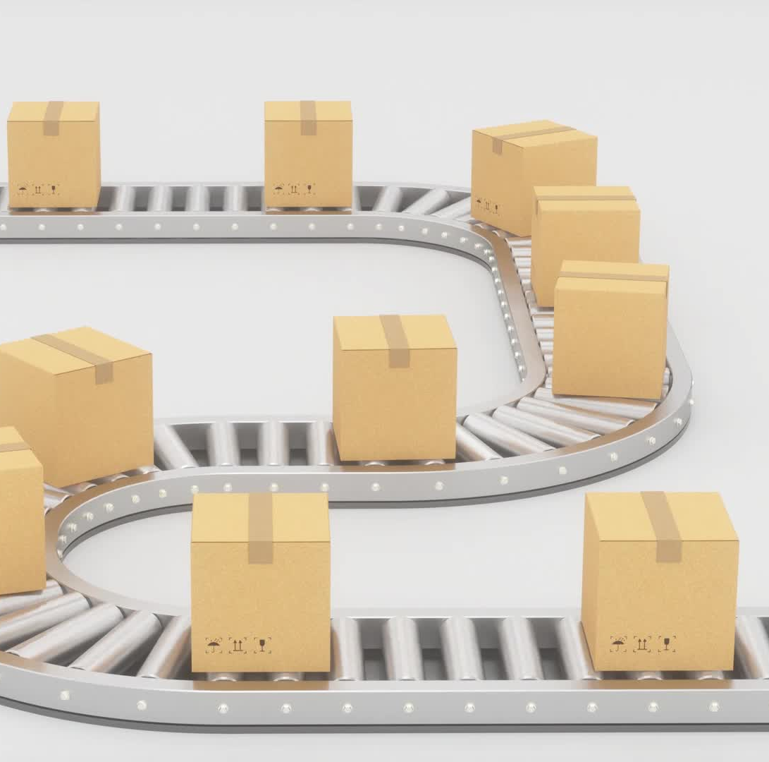
Benefits of Value Stream Management
Faster delivery of customer-centric products
Better customer experiences
Improved employee engagement & cross-functionality
Data and insights-driven decision making

Slide 9

Common Reality: Deployment Lead Times Requiring Months
Especially common in large or complex projects/organizations
High reliance on manual testing
Inefficient approval processes
Long lead time = poor outcomes
Complicated and inefficient value steam
Can result in a bad customer experience

Slide 10

DevOps Ideal: Deployment Lead Times of Minutes
Fast, constant feedback
Quickly implements changes in response to feedback
Continually checking small code changes into the version control repo
Utilizes immediate automated and exploratory testing
Uses modular, encapsulated architecture

Slide 11
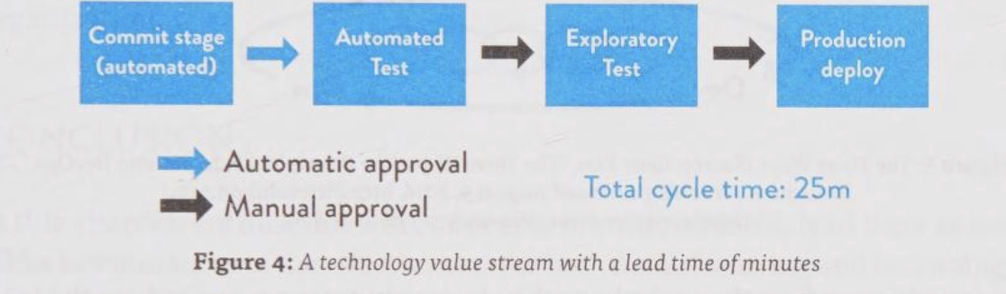
DevOps Ideal
The DevOps ideal flow, with a lead time of minutes, rather than months

Slide 12
References
References
Atlassian. (n.d.). What is Value Stream Management? Atlassian. https://www.atlassian.com/agile/value-stream-management
Kim, G., Humble, J., Debois, P., Willis, J., & Forsgren, N. (2021). The DevOps Handbook, Second Edition. IT Revolution.
Kingery, M. (2023, April). Using development value stream mapping to identify constraints to DevOps outcomes - AWS Prescriptive Guidance. Docs.aws.amazon.com. https://docs.aws.amazon.com/prescriptive-guidance/latest/strategy-devops-value-stream-mapping/introduction.html
LinkedIn Community. (2023, March 20). Learn how to use value stream mapping to optimize your engineering processes and reduce waste using lean principles. Linkedin.com. https://www.linkedin.com/advice/0/how-do-you-identify-eliminate-waste-your
Watts, S. (2024). Value Stream Management: A Brief Explainer | Splunk. Splunk. https://www.splunk.com/en_us/blog/learn/value-stream-management.html

